Slide 1
IMDB SCORE PREDICTION
NAME: SAHIR DEV Date: 10-05-2025
END-TO-END DATA SCIENCE PROJECT

Slide 2
AGENDA:
- Introduction & Objectives
- Data Collection & Cleaning
- Exploratory Data Analysis (EDA)
- Feature Engineering
- Modeling & Evaluation
- Model Interpretability & Insights
- Conclusions

Slide 3
Introduction & Objectives
1. Problem Statement:
-Predict IMDb ratings to help understand movie success.
2. Objectives:
-Build and tune a robust predictive model.
-Identify key factors (features) influencing movie ratings.
3. Implications:
-Inform content strategy, marketing, or production decisions.

Slide 4
Data Collection & Cleaning
1. Data Source:
- Details about the IMDb dataset (movies, ratings, cast, etc.).
2. Data Cleaning Steps:
- Remove unneccesary columns.
- Handling missing values and outliers.
- Data type conversion.
3. Outcome:
- Cleaned dataset ready for analysis.

Slide 5
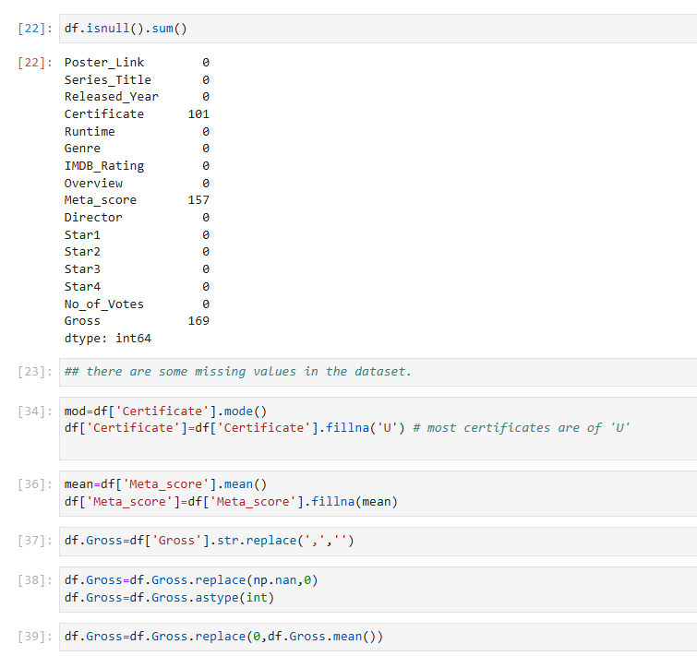

Slide 6
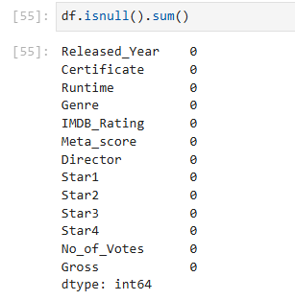
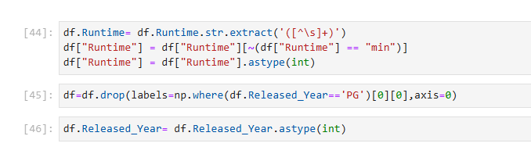
CONTINUE:

Slide 7
Exploratory Data Analysis (EDA)
1. Visualization Highlights:
- Distribution of IMDb Ratings, Meta Scores, etc.
-Distribution of every single Numeric columns(Features).
-Correlation and Heatmap for numeric columns(Features).
-Barplots for categorical columns.
2. Key Findings:
- Relationship between critical reception (Meta_score and No. of Votes) and IMDb ratings.
- Patterns in genre, runtime, and other variables.

Slide 8
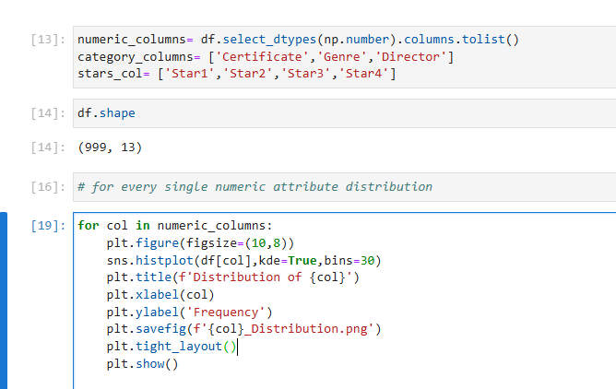
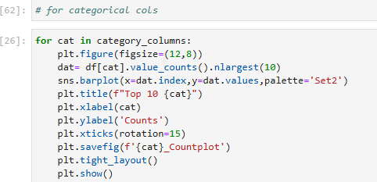

Slide 9
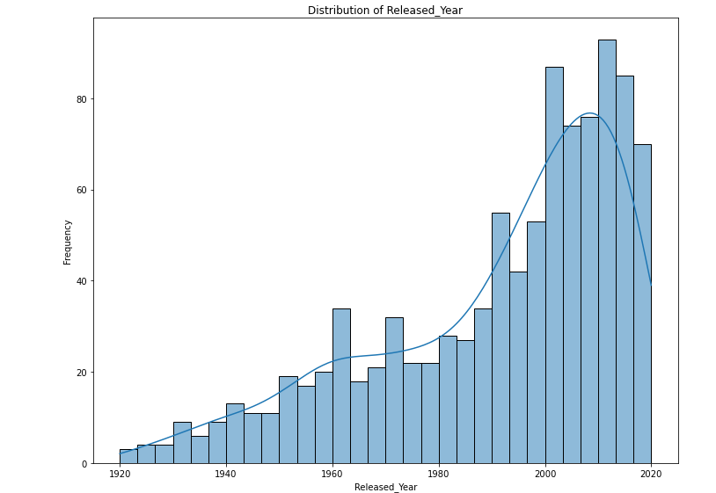
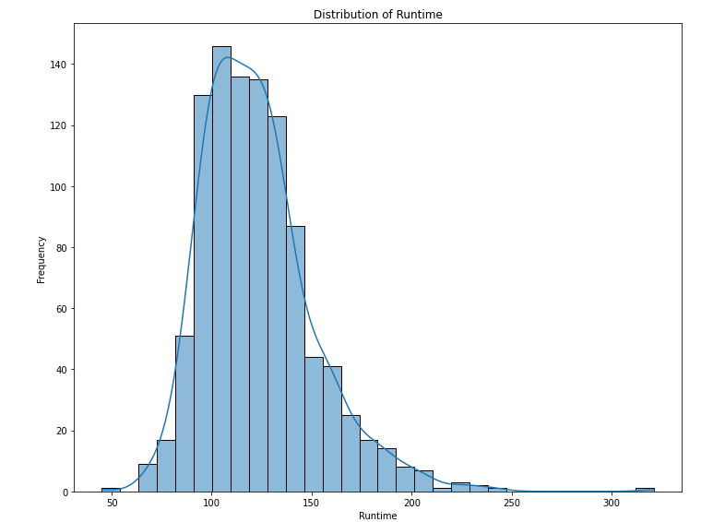
Distribution of every numeric attribute(Feature)

Slide 10
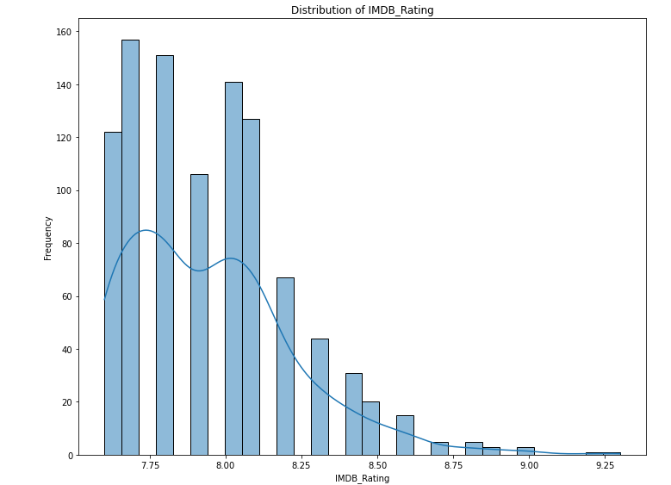
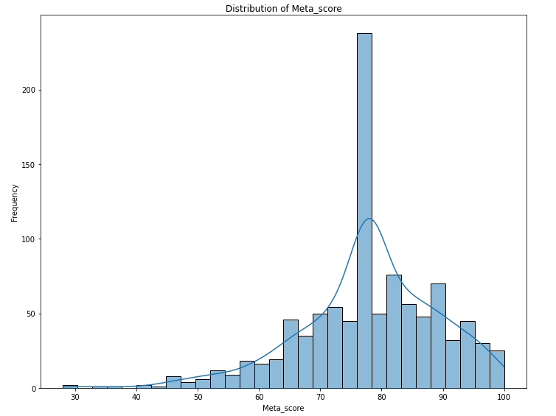

Slide 11
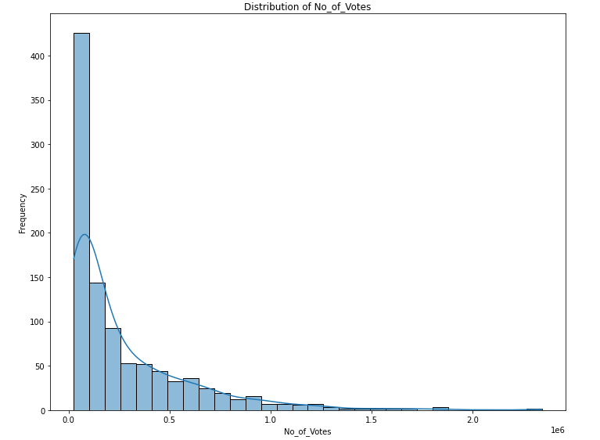
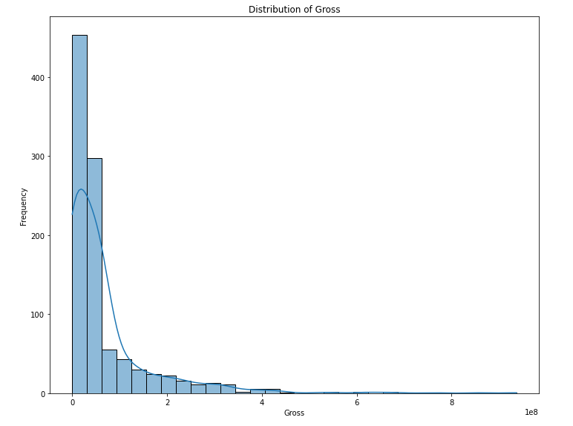

Slide 12
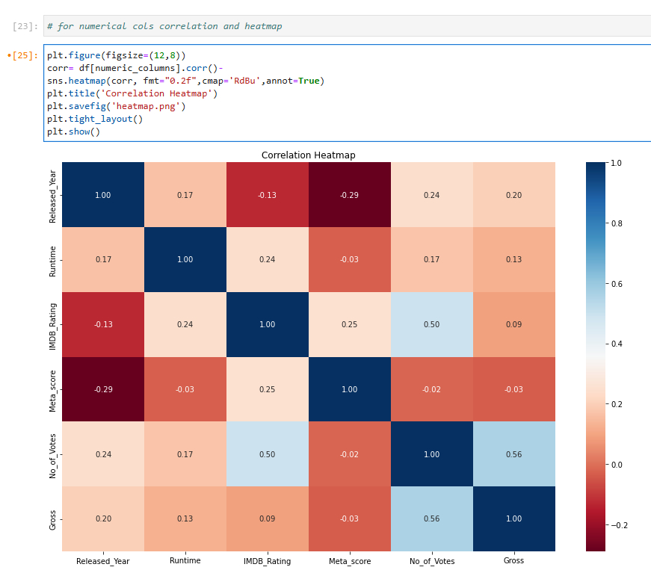

Slide 13
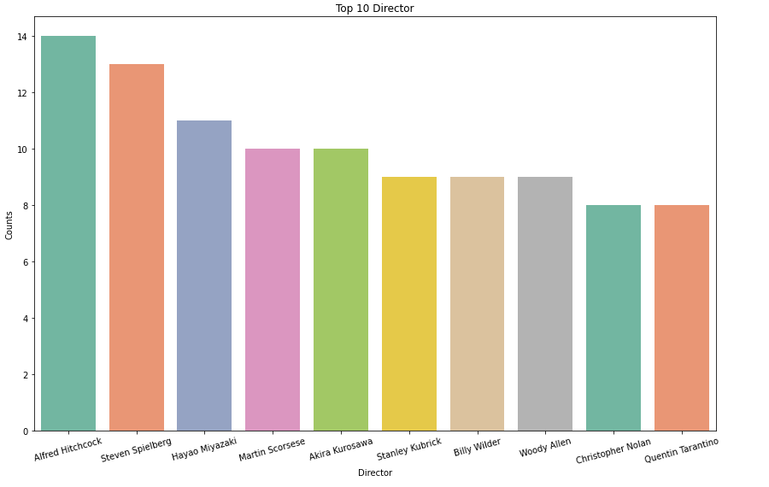
Barplots for every categorical attribute(Feature)

Slide 14
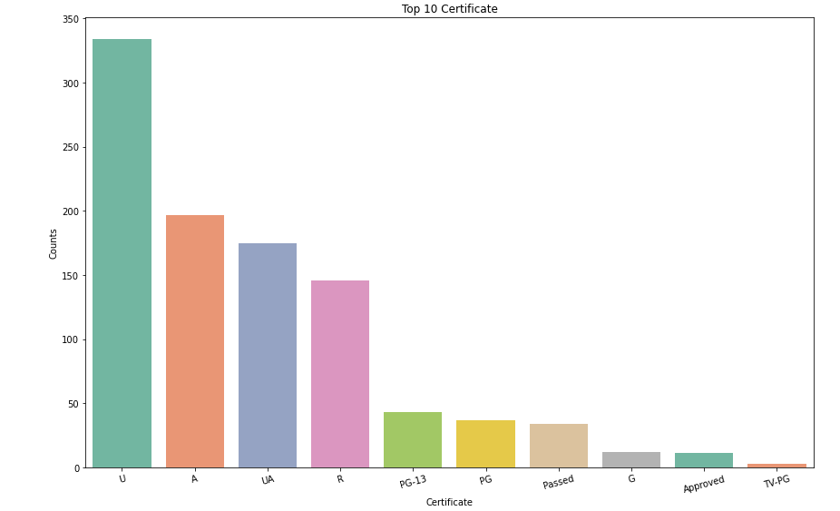

Slide 15
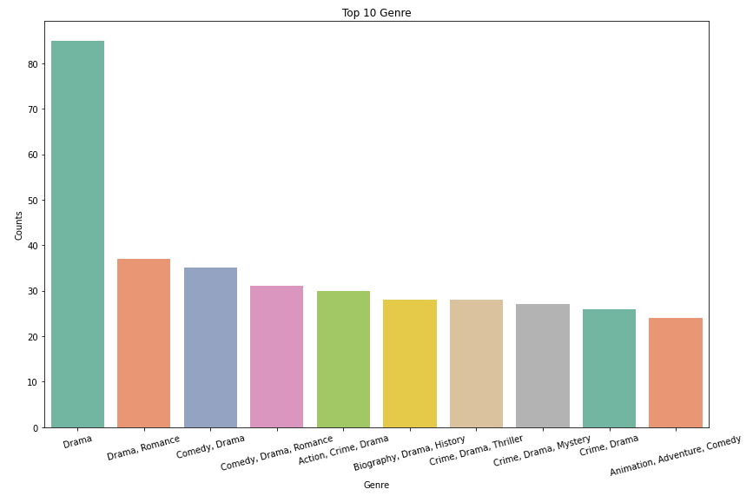

Slide 16
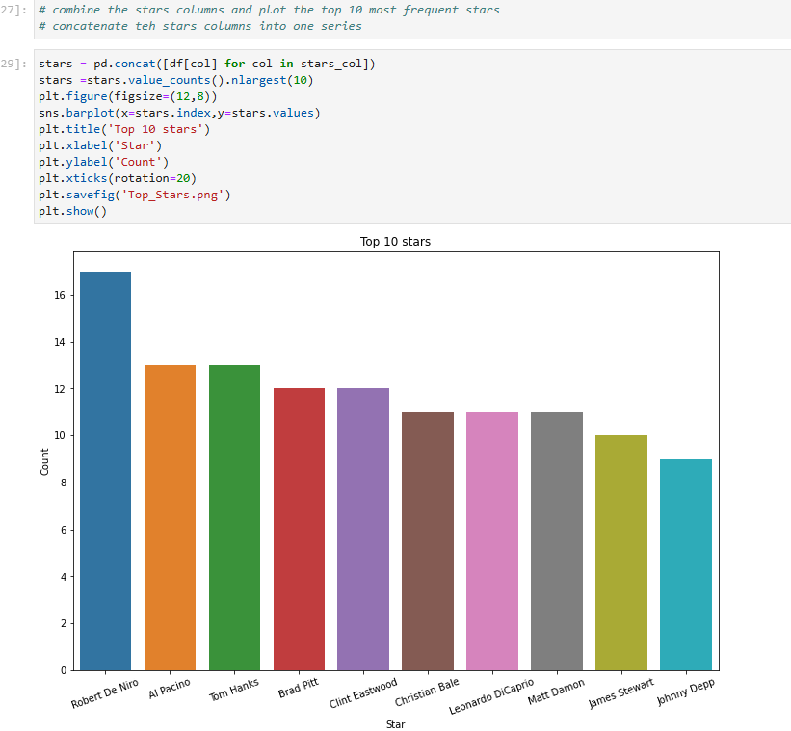

Slide 17
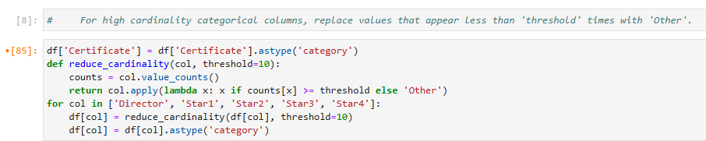
Feature Engineerining and Preprocessing
The "cardinality problem" in data preprocessing refers to the challenges that arise when dealing with categorical features (columns) that have a high number of unique values (high cardinality). So we ave high cardinality problem in our categorical columns which can slow down our training.
Reduce the noise from rarely occuring categories by grouping them into a single category as “others”. By solving this problem, we prevent overfitting, make model much faster and robust, reduces dimensionality.

Slide 18
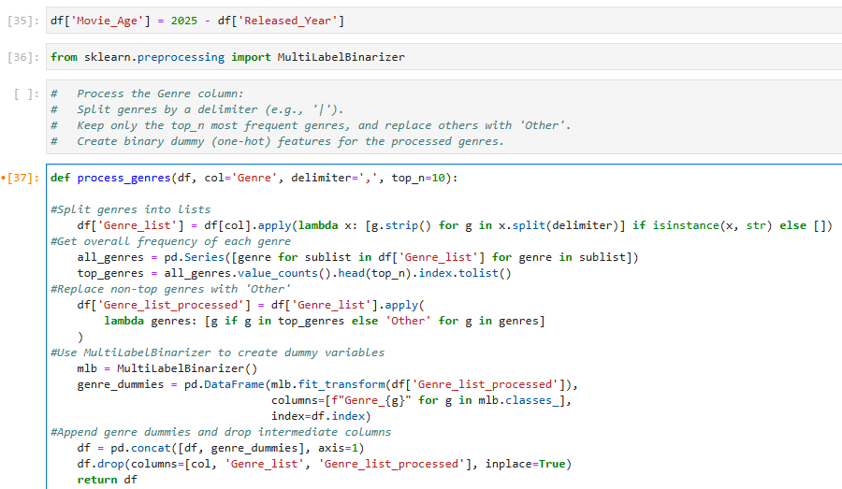

Slide 19
CONTINUE:
Importing MultiLabelBinarizer, which helps convert a list of genres into binary (0 or 1) format — ideal for machine learning.
One-Hot Encode with MultiLabelBinarizer.
It transforms genre lists into one-hot encoded format.
The resulting DataFrame has columns like Genre_Action, Genre_Drama, etc., each column has value of 0 or 1.
Merge back to original dataframe.
One-hot columns are added to the original DataFrame.
Original genre columns (including intermediate lists) are dropped.
Returns the cleaned DataFrame.
Handles multilabel features (like genre) effiecently.
Reduces noise by consolidating rare genres into 'Other'.

Slide 20
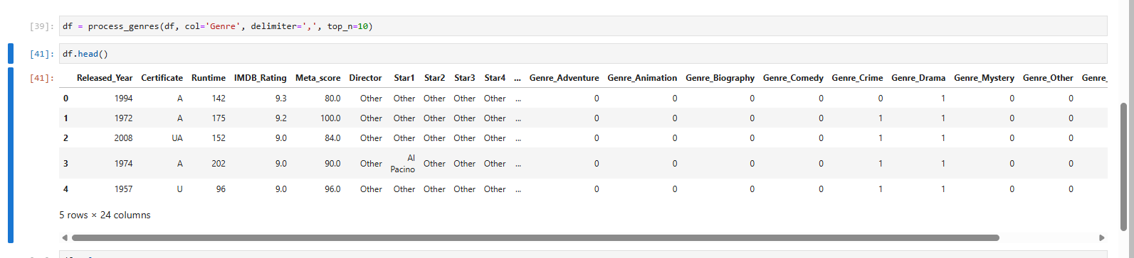

Slide 21
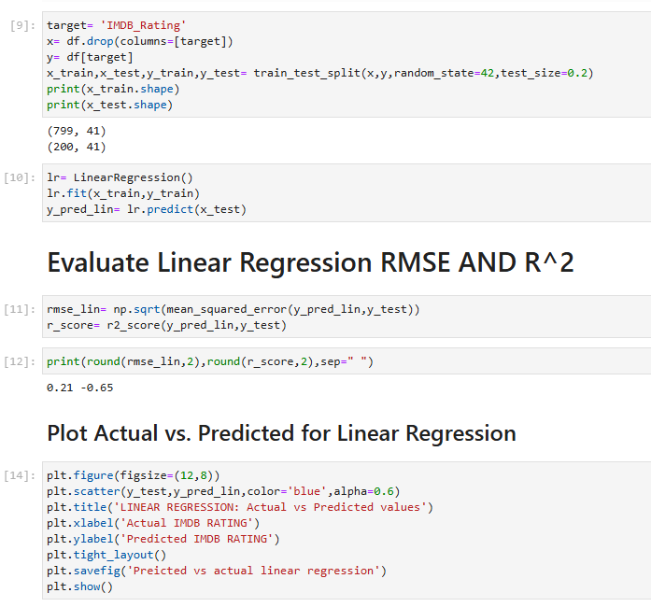
Baseline Modeling(LR), Advanced Modeling(RFR), HyperParameter Tuning And Evaluation.
We performed Linear Regression to predict IMDB Ratings using sciki-learn.
This model struggles to capture meaningful relationships, suggesting that linear regression might not be suitable for this task without stronger feature engineering or using a more complex model.
Performs worse that simply predicting the mean (-0.65)
So we need advance model to solve this problem

Slide 22
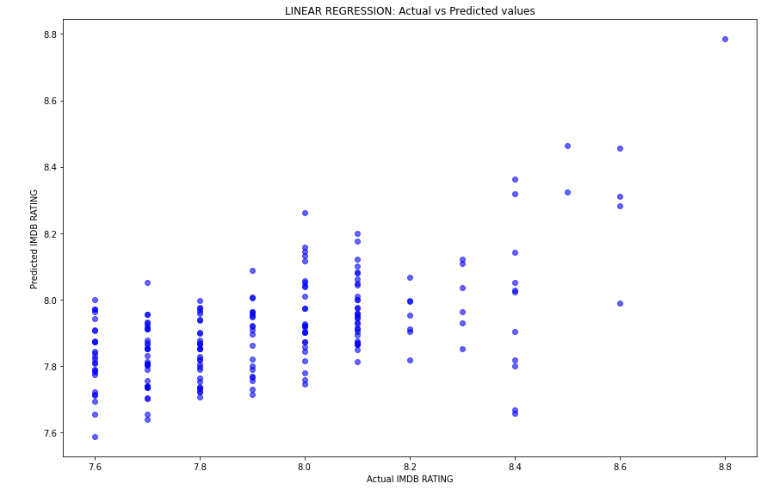

Slide 23
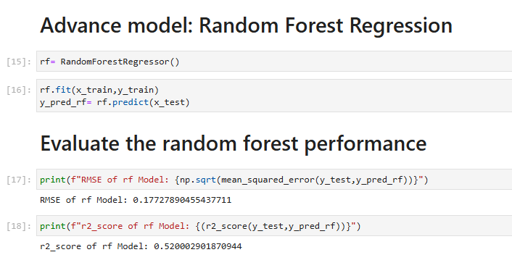
We perfrom RandomForest Regression using scikit-learn ensemble.
The model explains 52% of the variance in IMDb scores, which is a moderate fit.
Overall, this model performs significantly better than a linear regression.
RMSE indicates low prediction error with 0.17

Slide 24
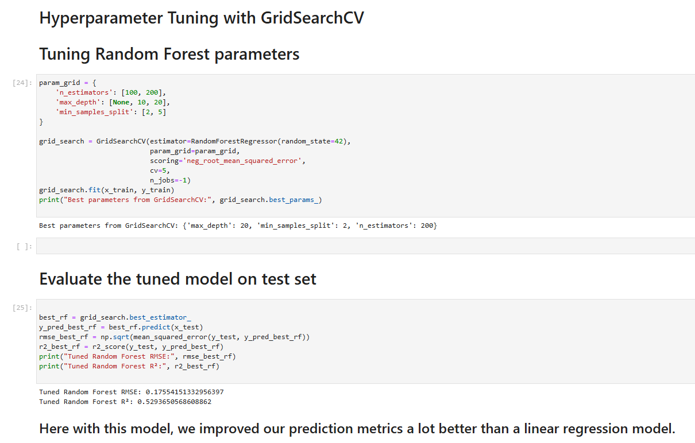

Slide 25
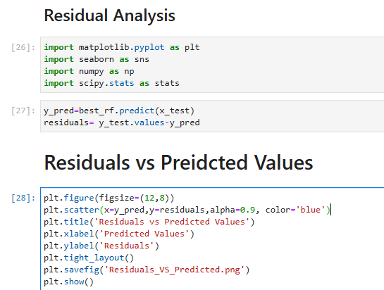
Visualization, Interpretation and Evaluation

Slide 26
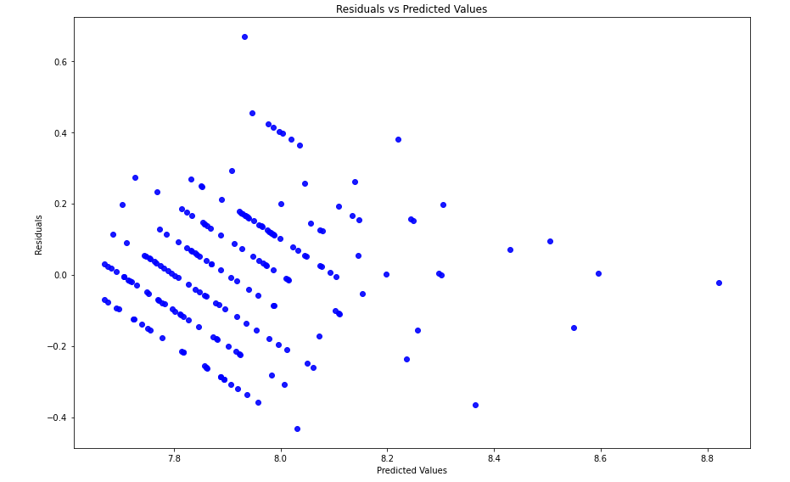
The residuals appear to be generally scattered around the horizontal line at zero (randomly), which is a positive sign. It suggests that, on average, the model does not systematically overpredict or underpredict IMDb ratings.

Slide 27
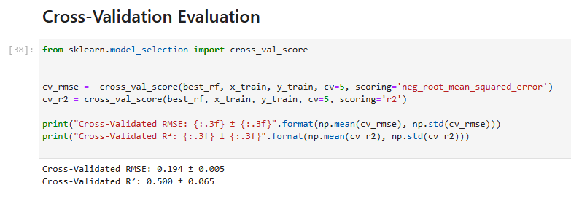
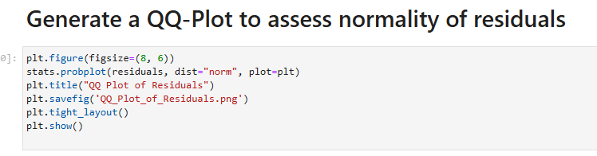
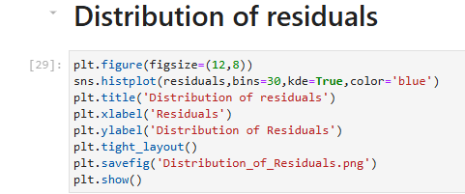
These cross-validated metrics confirm that the tuned Random Forest is a solid and stable model for predicting IMDb ratings.
Calculate cross-validated RMSE (using negative root mean squared error) and R².

Slide 28
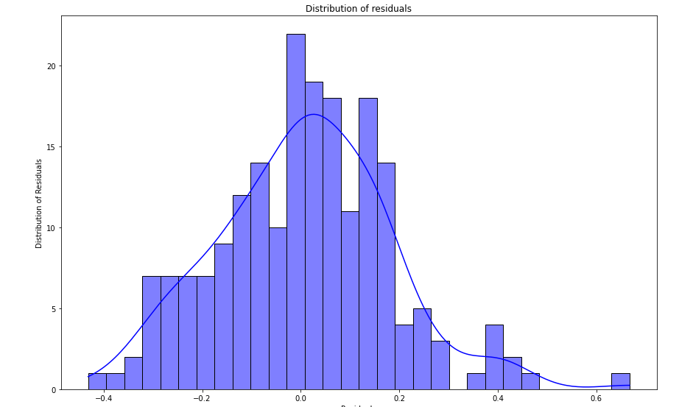
Most residuals centered around zero which suggests that model doesn't have systematic Bias. Overall shape of the distribution looks bell-shaped which illustrate that residuals have normal distributions.

Slide 29
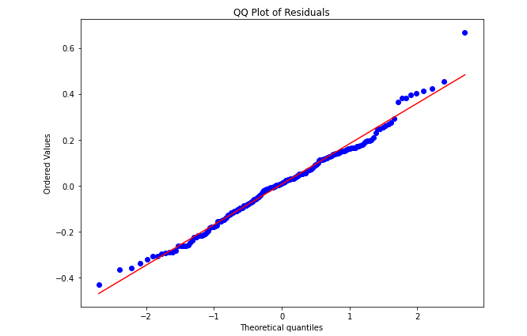
Majority of points align well with the line, the residuals are largely normal. This supports the assumption of normality in the errors for the model.

Slide 30
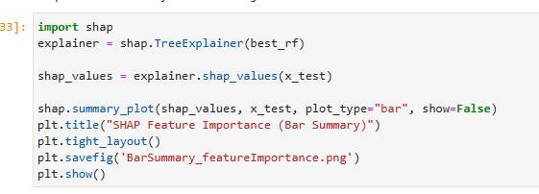
!pip install shap
Create SHAP values using TreeExplainer (efficient for tree-based models).
Compute SHAP values for a subset of the test set (you might use the entire X_test if it's not too large).
Plot a bar summary to see global feature importance via SHAP.

Slide 31
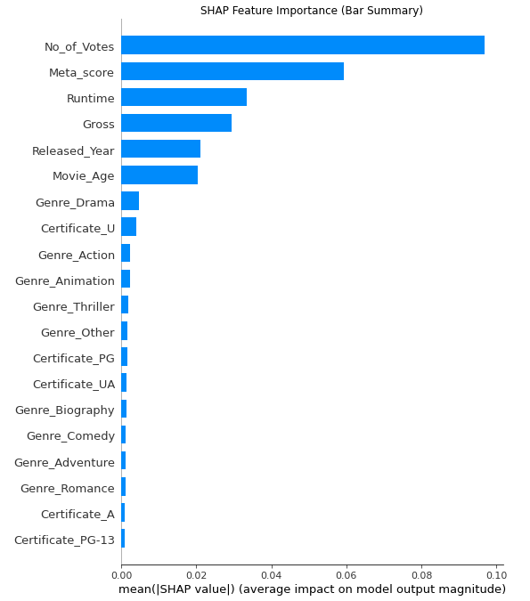
No_of_Votes had the highest impact on model predictions—indicating that the number of votes a movie gets strongly correlates with its rating.
Followed by Meta_score, Runtime, Gross, Released_Year, and Movie_Age.

Slide 32
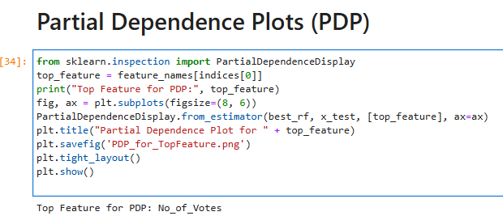
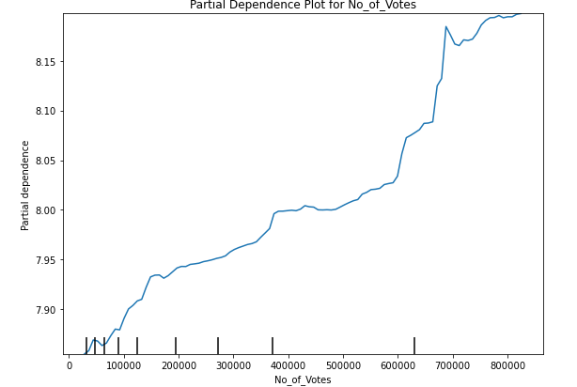
This code generates a Partial Dependence Plot (PDP) for the top feature: No_of_Votes—in a Random Forest model trained to predict IMDb scores
The resulting plot suggests that as No_of_Votes increases, the model's predicted IMDb score also rises—indicating a positive relationship.

Slide 33
Conclusion
1. Predictive Performance:
After comprehensive cleaning and feature engineering, a tuned Random Forest Regressor cut error to RMSE ≈ 0.17 and explained ≈ 52 % of rating variance, a decisive improvement over the linear-regression baseline (R² = –0.65).
2. Key insights of IMDb Scores:
Popularity and critical-consensus signals matter most:
No_of_Votes (strongest effect)
Meta_score
Runtime, Gross, Released_Year / Movie_Age
Genre and certificate tags contribute far less once high-cardinality noise is collapsed into “Other.”
3. Business Implications:
Studios or streaming platforms can prioritise titles with strong critic scores and sustained audience engagement (votes) to boost average ratings.
4. Model Robustness & Interpretability:
Residual diagnostics show no systematic bias, and SHAP + PDP visualisations make the model transparent enough for stakeholder trust and actionable what-ifs.

Slide 34
Continue
5. Limitations & Next Steps:
An R² of 0.52 leaves room for richer features—e.g. social-media sentiment, cast star-power, release-window effects.
Bottom line: A data-driven, interpretable workflow now predicts IMDb ratings with practical accuracy and clear levers for content, marketing, and investment teams to pull.

